Slide 1
RSI vs Stochastic Oscillator
John Parker, Luke Welch, Miguel Gutierrez

Slide 2
Our Team
SESSION
Luke Welch
B.S. Physics, B.A. Mathematics, B.B.A Finance
John Parker
B.S. Math, B.S. Economics
Miguel Gutierrez
B.A. Computer Science, B.B.A Finance

Slide 3
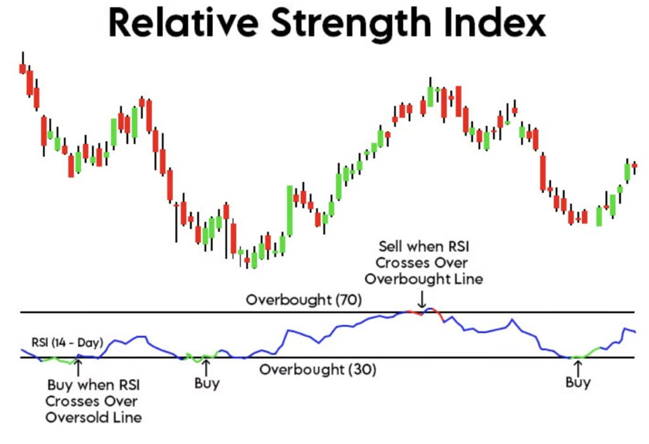
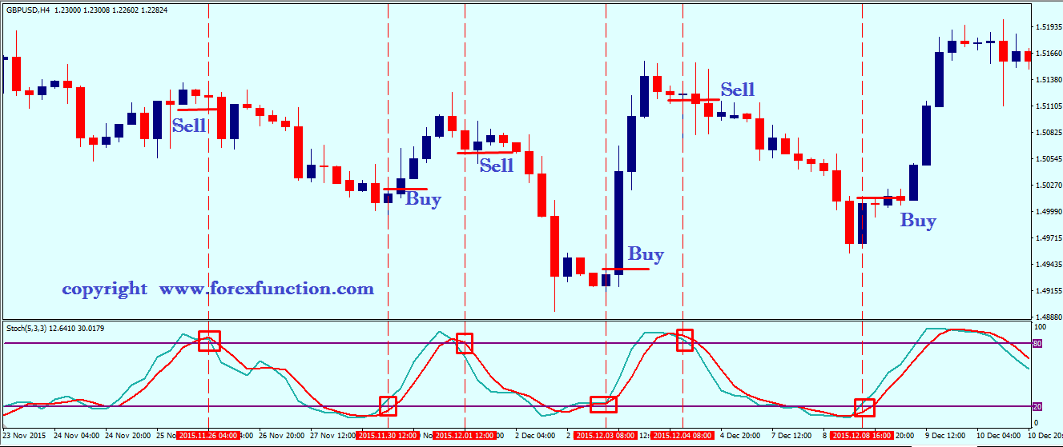
Intro: RSI vs. Stochastic Oscillator Strategies
OUR PROJECT
Objective: Evaluate and compare the performance of two technical strategies (RSI and Stochastic Oscillator) across a range of stocks.
Stocks grouped and analyzed by beta category to control for volatility exposure.
RSI (Relative Strength Index):
Measures momentum; signals overbought >70, oversold <30.
Stochastic Oscillator:
Compares closing price to price range; signals overbought >80, oversold <20.
Both aim to capture short-term reversals.

Slide 4
Metrics and Picking Stocks
GETTING STARTED
Metrics
RSI:
Momentum indicator showing the speed and volume of recent trading of a stock. Seeks to determine when a stock is overbought or oversold, on a scale of 0 to 100. Traditionally, a number below 30 indicates oversold, and a number over 70 indicates overbought.
Stochastic Oscillator:
Different style of indicator that focuses on the price of an asset relative to the trailing 14 days, using the highest and lowest closing values, comparing it to its current price.
Methods
Used stratified random sampling for 40 companies in the S&P500, stratified by beta in steps of .5
The strata were chosen so that different strategies could be applied and modified based off Beta bands, to see which strategies would be more effective under different applications and scenarios.
Results will be broken up by different Beta categories to give an idea of what would be more effective. We will seek to smooth out volatility and adjust metrics for Beta.

Slide 5
Optimization
MAKING IT BETTER
ADJUSTMENTS
Low-Beta Adjustments: Adjusted RSI bands to be smaller in low beta scenarios, to facilitate liquidity.
Higher-Beta Adjustments: Widen both sets of bands towards the end of the beta distribution, to ensure that false signals are not generated by the increased volatility.
Low Beta RSI bands are 35 65.
High Beta RSI bands are 25 75.
WHY
RSI has the issue of having low liquidity in low volatility stocks, due to less signals being produced.
Higher volatility stocks have the issue of producing false signals, due to the inherent volatility of the underlying assets.
Oscillator cannot be adjusted for Beta, as this metric is less about momentum and more to do with putting the price relative to an overall range rather than momentum.

Slide 6

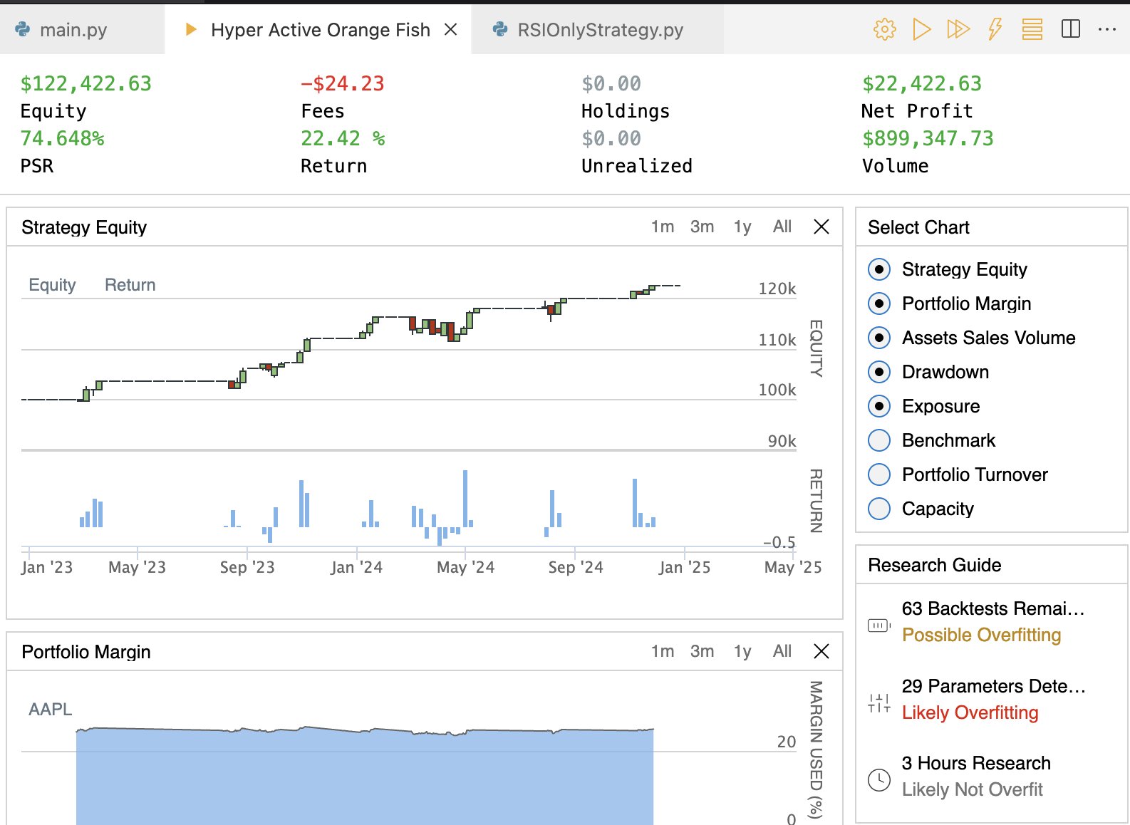
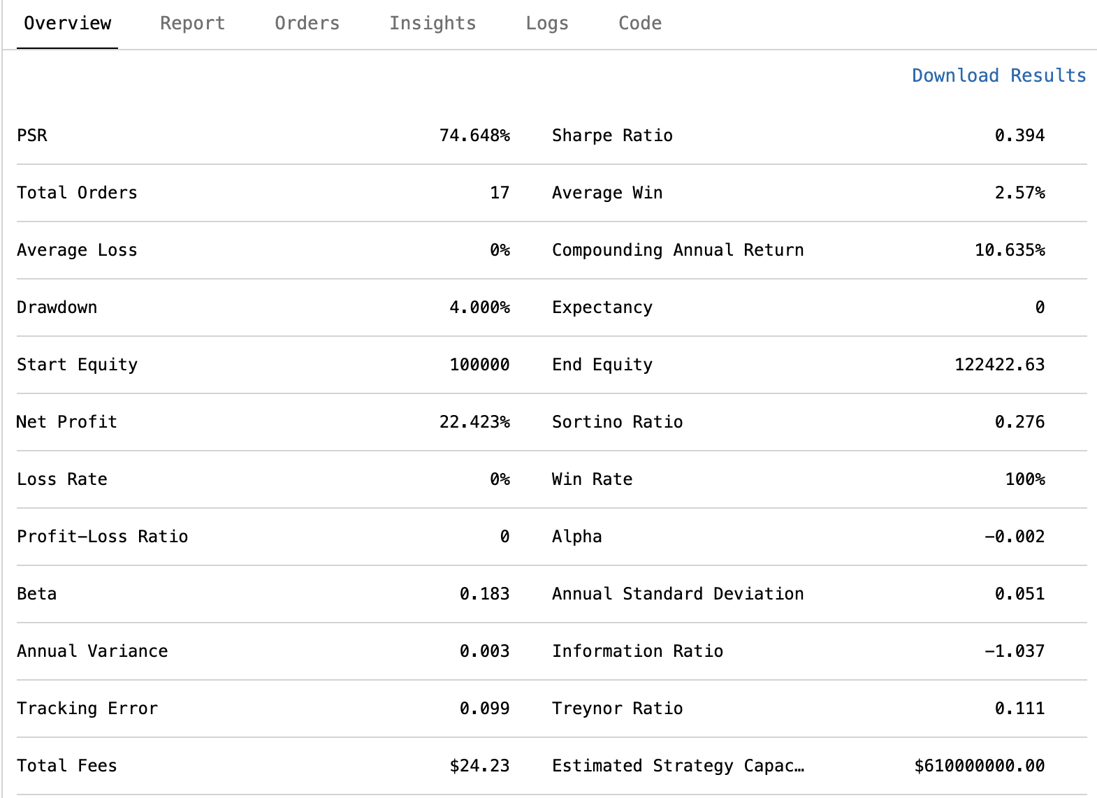
Backtesting Methodology
BACKTESTING
Using QuantConnect for backtesting we ran both strategies for 40 stocks and aggregated the results

Slide 7
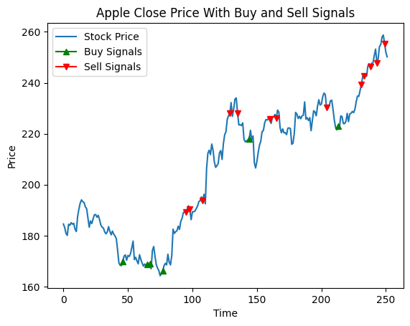
Calculations
DOING THE MATH
TA-Lib to compute computationally
RSI with 14-day period
Stochastic Oscillator with 14 day %k Period
Generate Buy/Sell signals based on rules
Utilizing the Momentum of the stock price to find winning trades

Slide 8
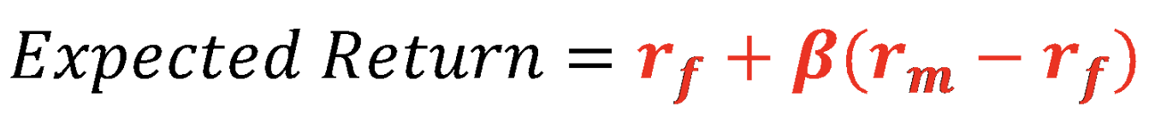
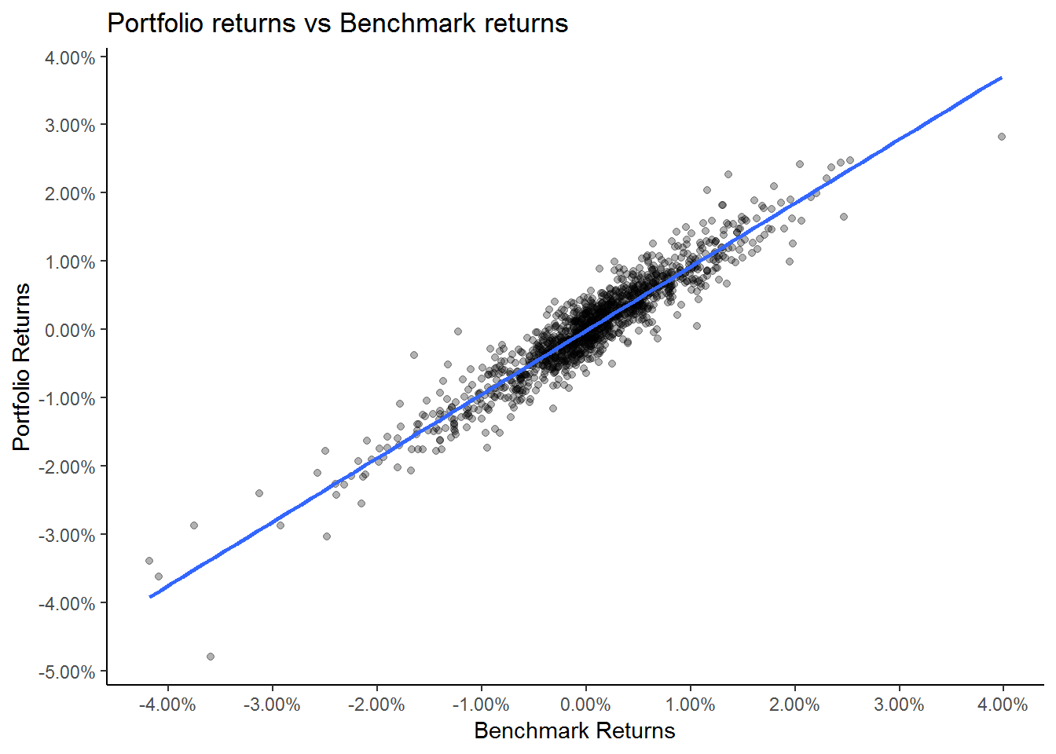
Statistical Analysis Methods
METHODS
Beta Regression
Stock yield as independent variable
Strategy yield as dependent variable
2-norm least squares regression
CAPM Model
Adjusts expected returns for various beta
Stochastic Oscillator with 14 day %k Period

Slide 9
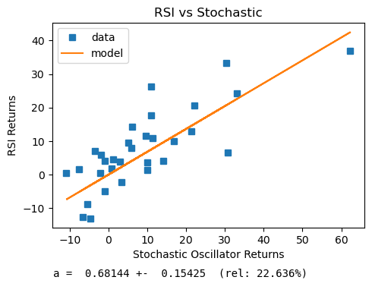
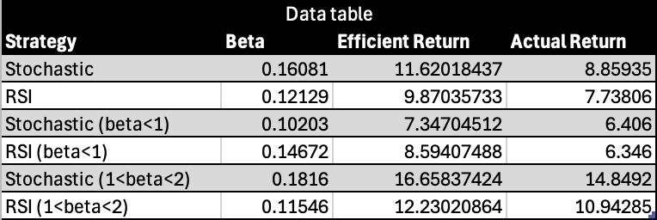
Results
OUTPUTS

Slide 10
Error Analysis
WHAT CAN BE IMPROVED
Statistical Errors:
Beta Regression Uncertainty
Errors in Free Data
Risk-Free Rate Uncertainty
Round-off Errors
Systematic Errors:
Back Testing Methodology
Assumptions from CAPM Model
Unknown TA-Lib Mistakes
Any Other Personal Mistakes

Slide 11
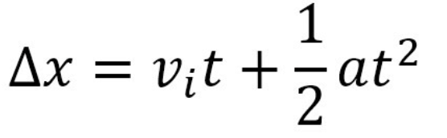
Potential Next Steps
WHAT'S NEXT
Various Kinematic Strategies
Stochastic Momentum
RSI Momentum
Patrick Mulloy’s Acceleration Bands
Utilize/Research Other Momentum Indicators
Classical Rate of Change (ROC) indicators
Moving Average Convergence/Divergence (MACD)
Commodity Channel Index (CCI)
Use of leverage, potential short positions instead of selling, etc.

Slide 12
Conclusion
FINAL JUDGEMENTS
OVERVIEW
Unadjusted Oscillator performed better overall under all except incredibly high Beta groups (95% of S&P 500). Meanwhile, very high Beta stocks performed better under adjusted RSI, but it is more erratic (excluded from regression).
Lower Beta stocks had similar returns with RSI as with Stochastics, but it is statistically insignificant.
Beta-adjusted RSI did better than unadjusted, whereas the opposite is true for oscillators.
These methods are inefficient compared to buy and hold.
Low Beta Stocks
Stochastic strategy is better, but it is much less pronounced, compared to Beta- adjusted RSI. Adjusted RSI may be more effective depending on the security.
Medium/ High Beta Stocks
Stochastic is more effective, driving higher returns and reducing risk
Ultra-High Beta Stocks
RSI strategy, with wider bands to adjust for higher Beta volatility

Slide 13
Q&A

